Slide 1




Mini Project - III Fake news detection program
Made by: Apurv Kumar

Slide 2
Introduction:
The advent of the World Wide Web and the rapid adoption of social media platforms (such as Facebook and Twitter) paved the way for information dissemination that has never been witnessed in the human history before. Besides other use cases, news outlets benefitted from the widespread use of social media platforms by providing updated news in near real time to its subscribers. The news media evolved from newspapers, tabloids, and magazines to a digital form such as online news platforms, blogs, social media feeds, and other digital media formats. It became easier for consumers to acquire the latest news at their fingertips. Facebook referrals account for 70% of traffic to news websites. These social media platforms in their current state are extremely powerful and useful for their ability to allow users to discuss and share ideas and debate over issues such as democracy, education, and health. However, such platforms are also used with a negative perspective by certain entities commonly for monetary gain and in other cases for creating biased opinions, manipulating mindsets, and spreading satire or absurdity. The phenomenon is commonly known as fake news.
There has been a rapid increase in the spread of fake news in the last decade, most prominently observed in the 2016 US elections. Such proliferation of sharing articles online that do not conform to facts has led to many problems not just limited to politics but covering various other domains such as sports, health, and science. One such area affected by fake news is the financial markets, where a rumor can have disastrous consequences and may bring the market to a halt.

Slide 3
Applications:
We Can use this program to separate fake news from real news and prevent chaos that may happen because of fake rumors.

Slide 4
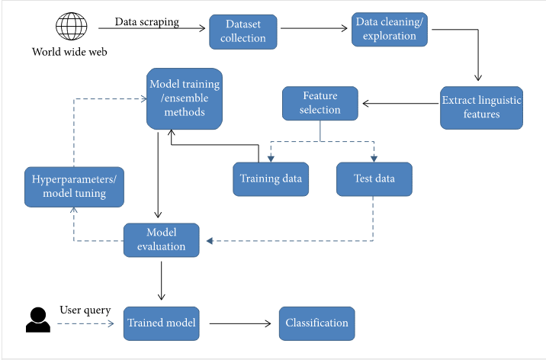
Conceptual framework:
In our proposed framework, as illustrated in Figure, we are expanding on the current literature by introducing ensemble techniques with various linguistic feature sets to classify news articles from multiple domains as true or fake. The ensemble techniques along with Linguistic Inquiry and Word Count (LIWC) feature set used in this research are the novelty of our proposed approach.

Slide 5
Algorithms and Tools used:
We will use the following learning algorithms in conjunction with our proposed methodology to evaluate the performance of fake news detection classifiers.
Logistic Regression: As we are classifying text on the basis of a wide feature set, with a binary output (true/false or true article/fake article), a logistic regression (LR) model is used, since it provides the intuitive equation to classify problems into binary or multiple classes.
Convolutional Neural Network.
Datasets : The datasets we will use in this study are open source and freely available online. The data includes both fake and truthful news articles from multiple domains. The truthful news articles published contain true description of real-world events, while the fake news websites contain claims that are not aligned with facts. The conformity of claims from the politics domain for many of those articles can be manually checked with fact checking websites such as politifact.com and snopes.com.

Slide 6
Literature survey:
Abstract: With the widespread dissemination of information via digital media platforms, it is of utmost importance for individuals and societies to be able to judge the credibility of it. Fake news is not a recent concept, but it is a commonly occurring phenomenon in current times. The consequence of fake news can range from being merely annoying to influencing and misleading societies or even nations. A variety of approaches exist to identify fake news. By conducting a systematic literature review, we identify the main approaches currently available to identify fake news and how these approaches can be applied in different situations. Some approaches are illustrated with a relevant example as well as the challenges and the appropriate context in which the specific approach can be used.
Keywords: Fake news, Machine learning, Linguistics, Semantics, Syntax, Algorithms, Digital tools, Social media.
Findings: There are many ways to approach this problem and the approach we chose is
Machine Learning Approach: Machine learning algorithms can be used to identify fake news. This is achieved through using different types of training datasets to refine the algorithms. Datasets enables computer scientists to develop new machine learning approaches and techniques. Datasets are used to train the algorithms to identify fake news. How are these datasets created? One way is through crowdsourcing.

Slide 7
Scope of project:
According to our group this project is very good in this time when people are afraid of this pandemic, many people are using fake news and fake rumors to their advantage which can be solved using this program.

Slide 8
References:
A. Douglas, “News consumption and the new electronic media,” The International Journal of Press/Politics, vol. 11, no. 1, pp. 29–52, 2006. View at: Publisher Site | Google Scholar
J. Wong, “Almost all the traffic to fake news sites is from facebook, new data show,” 2016. View at: Google Scholar
D. M. J. Lazer, M. A. Baum, Y. Benkler et al., “The science of fake news,” Science, vol. 359, no. 6380, pp. 1094–1096, 2018. View at: Publisher Site | Google Scholar
S. A. García, G. G. García, M. S. Prieto, A. J. M. Guerrero, and C. R. Jiménez, “The impact of term fake news on the scientific community scientific performance and mapping in web of science,” Social Sciences, vol. 9, no. 5, 2020. View at: Google Scholar

Slide 9
Source: https://www.hindawi.com/journals/complexity/2020/8885861/
THANK YOU
By – Apurv Kumar
CSE 2
2193052

